Slide 1
PSYC 740 Theory Building and Model Testing
Session 6 – Confirmatory factor analysis

Slide 2
Overview of Today’s Class
Lecture: CFA
R
CFA using lavaan

Slide 3
Confirmatory Factor Analysis
CFA Overview
CFA Model specification
CFA Model identification
Formative vs. reflective models

Slide 4
What is Confirmatory Factor Analysis (CFA)?
Factor analysis involves representing covariance among a set of measured variables with a smaller number of (latent) factors.
Exploratory factor analysis (EFA) allows the data to provide a factor pattern showing which variables load on which of a smaller number of factors
CFA does not allow the data to dictate the factor patterns
In CFA, the user must specify:
The number of factors
Which variables load on which factors (i.e., the factor structure)

Slide 5
CFA Terminology: Measures → Constructs
Measured variable
Observed variables (aka indicators or manifest variables)
Represent the “building blocks” of a latent construct
Latent construct
Unobserved variable in the model
Construct derived from measured variables in the measurement model
Elements from which hypothesized relationships are formed
Benefits of Using Latent Constructs
Specify measurement error
Represent theoretical concepts
Improve statistical estimation

Slide 6
CFA = Measurement Models in SEM
Starting Point:
Relating indicators to latent constructs
Indicator:
Known as measured, manifest or observed variables
Actual measurement or response of a characteristic for the individual observation
Assumed to:
Contain measurement error
Be representative of the associated latent construct

Slide 7
CFA Graphical Components
Latent (construct) variables
Measured (observed) indicator variables
Directional Relationships (e.g., factor loadings)
Non-Directional (Correlational) Relationships
Error Variances

Slide 8
Conceptualizing Latent Variables
Most common structure is “reflective”
What do the arrows imply?
Then, what is the latent variable?
Latent Variable
X₁
X₂
X₃
X₄
e₁ e₂ e₃ e₄

Slide 9
Conceptualizing Latent Variables
Latent variables = representation of the variance shared among the variables
common variance without error or specific variance
Unique variance represented by error term

Slide 10
Using Indicators to Represent Constructs
What are some constructs and indictors from your discipline?

Slide 11
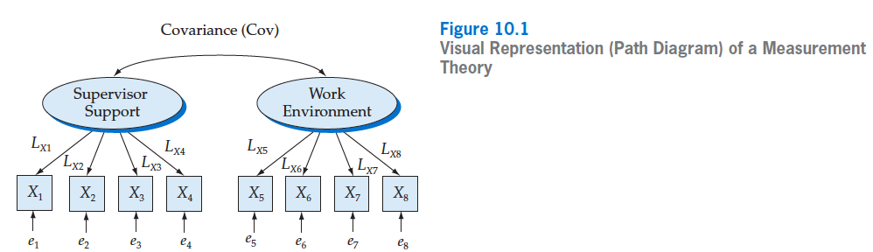
Measurement Theory
Measurement Theory specifies what process explains the structure of the covariance matrix.

Slide 12
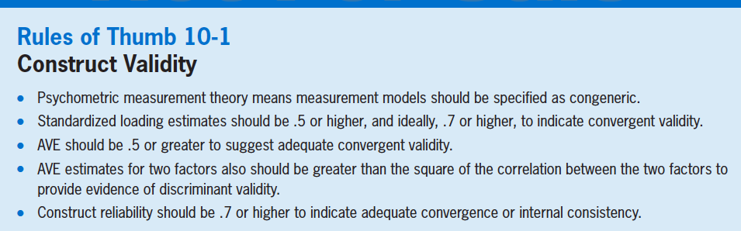
Guidelines for Convergent Validity

Slide 13
Developing the Overall Measurement Model
Congeneric (unidimensional) measurement model is consistent with good psychometric theory
No cross-loadings allowed
Error-variance terms are completely independent (unrelated)

Slide 14
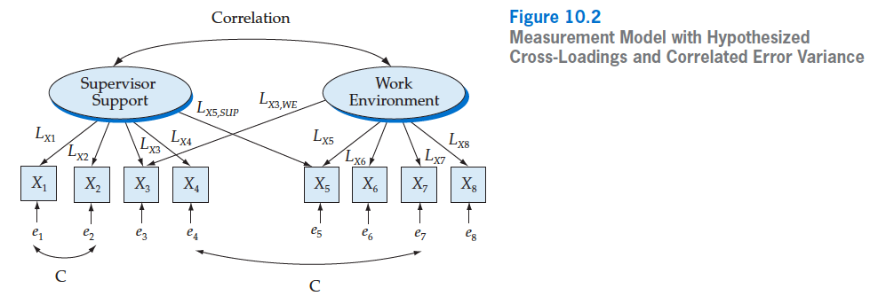
Developing the Overall Measurement Model
Model inconsistent with good psychometric theory

Slide 15
CFA Terminology: Parameters
Parameters usually estimated in a CFA model:
Factor loadings
Interpreted as regression coefficients
Can be reported as unstandardized or standardized values
Error variances
Residual variance in the indicators not explained by the latent factor
Factor variance
Variance in the latent construct
Factor covariances/correlations
If multiple latent factors are included in the CFA model

Slide 16
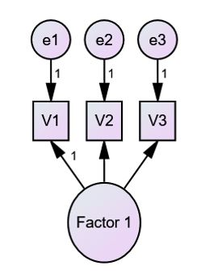
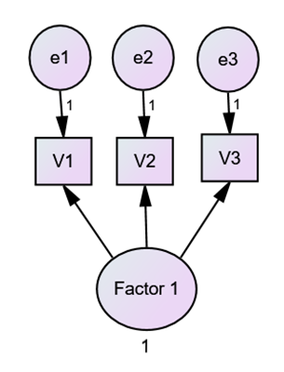
Setting the Metric of Latent Variables
Latent variables don’t have any inherent scale. As a result, the metric of latent variables need to be “set”.
Two Methods
1. Fix the factor loading for one of the indicators to 1
2. Fix the variance of the latent variable to 1

Slide 17
Model Specification and Estimation With Indicators
A two-construct, two indicator CFA model.
The input data for this model are the correlations/covariances among the indicator variables (X₁ to X₄)
The model parameters (i.e., the loadings of each variable on the construct and the correlation between constructs) are estimated to provide the closest fit between the predicted correlations/covariances and the input data.
CORR_{AB}
A
B
L₁
L₂
L₃
L₄
X₁
X₂
X₃
X₄

Slide 18
Effect Decomposition and Model Estimation
To “solve” for the model parameters, we first specify the effects for each correlation and then estimate the parameters which give the best overall fit
CORR_{AB}
A
B
L₁
L₂
L₃
L₄
X₁
X₂
X₃
X₄
Relationship | Effects | Relationship | Effects
X₁ – X₂ | L₁ * L₂ | X₂ – X₃ | L₂ * CORR_{AB} * L₃
X₁ – X₃ | L₁ * CORR_{AB} * L₃ | X₂ – X₄ | L₂ * CORR_{AB} * L₄
X₁ – X₄ | L₁ * CORR_{AB} * L₄ | X₃ – X₄ | L₃ * L₄

Slide 19
Model Prediction
The predicted relationships between each indicator variable are (a) calculations of each effect and then (b) the sum of effects for each correlation
CORR_{AB}= .3
Assume the following standardized parameter estimates:
L₁ = .7
L₂ = .6
L₃ = .75
L₄ = .55
CORR_{AB} = .3
A
B
L₁= .7
L₂= .6
L₃= .75
L₄= .55
X₁
X₂
X₃
X₄
Relationship | Predicted Effects | Relationship | Predicted Effects
X₁ – X₂ | _{.7 * .6 = .42} | X₂ – X₃ | _{.6 * .3 * .75 = .135}
X₁ – X₃ | _{.7 * .3 * .75 = .1575} | X₂ – X₄ | _{.6 * .3 * .55 = .099}
X₁ – X₄ | _{.7 * .3 * .55 = .1155} | X₃ – X₄ | _{.75 * .55 = .4125}

Slide 20
The Primary Objective: Calculating the Implied/Estimated Covariance Matrix
Covariance between variables
Model estimated to maximize “fit” of actual/input and implied/estimated covariance matrices
Implied/estimated covariances -- Trace all paths from any measured variable to another measured variable, multiplying parameters to get the covariance
Unstandardized Example:
Estimated COV_{X1X2} =
L₁ * VAR_{C1} * COV_{C1C2} * VAR_{C2} * L₂
Residual_{X1X2} =
Actual COV_{X1X2} – Estimated COV_{X1X2}
COV_{C1C2}
C₁
C₂
L₁ L₂
X₁
X₂

Slide 21
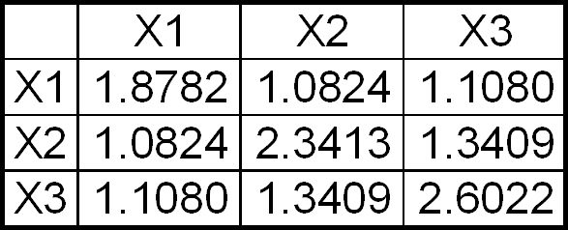
Example: Implied Covariance Matrix Within Construct
Variance of measured variable:
Explained variance by LV + error
Loading² * Var_{LV} + error variance
Covariance of two measured variables (X₁ and X₂):
Loading X₁ * Var_{LV} * Loading X₂
Example Calculations:
Variance X₁
(.9457² * 1 ) + .9838 = 1.8782
Covariance X₁X₂
.9457 * 1 * 1.1445 = 1.0824
LV
(1.00)
.9457 1.1445 1.1716
X1
X2
X3
.9838 1.0314 1.2296

Slide 22
What is a Residual in SEM/Path Analysis?
Residuals do not relate to individual respondents, but rather the data elements of the input covariance matrix
Residual_{X1X2} = Actual COV_{X1X2} – Estimated COV_{X1X2}
Residuals can denote which measured variable relationships are not well estimated by the specified model
Residual for every variance and covariance in the data structure

Slide 23
Identification
Identification provides the “rules” for estimating unique effects from the path
Identification is necessary for model estimation
A level of model identification is based on:
Is it theoretically possible to derive a unique estimate of each parameter?
Are the number of parameters to be estimated in the model less than, equal to, or more than the total number of unique elements in the variance-covariance matrix?
Observations refer to the number of elements in the variance-covariance matrix and not sample size
Is the model recursive?

Slide 24
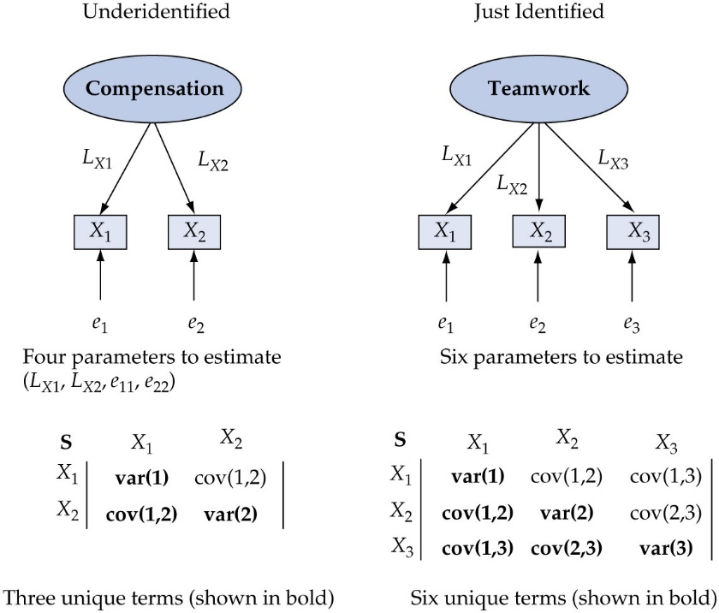
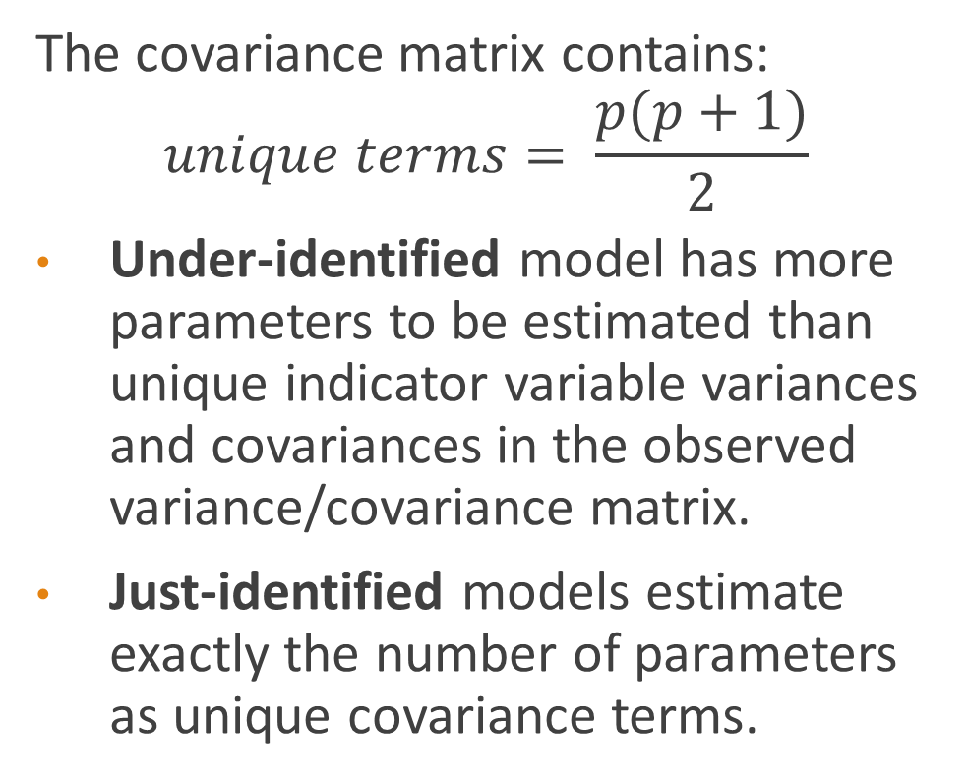
Identification
The covariance matrix contains:
$$unique terms= \frac{p(p+1)}{2}$$
Under-identified model has more parameters to be estimated than unique indicator variable variances and covariances in the observed variance/covariance matrix.
Just-identified models estimate exactly the number of parameters as unique covariance terms.

Slide 25
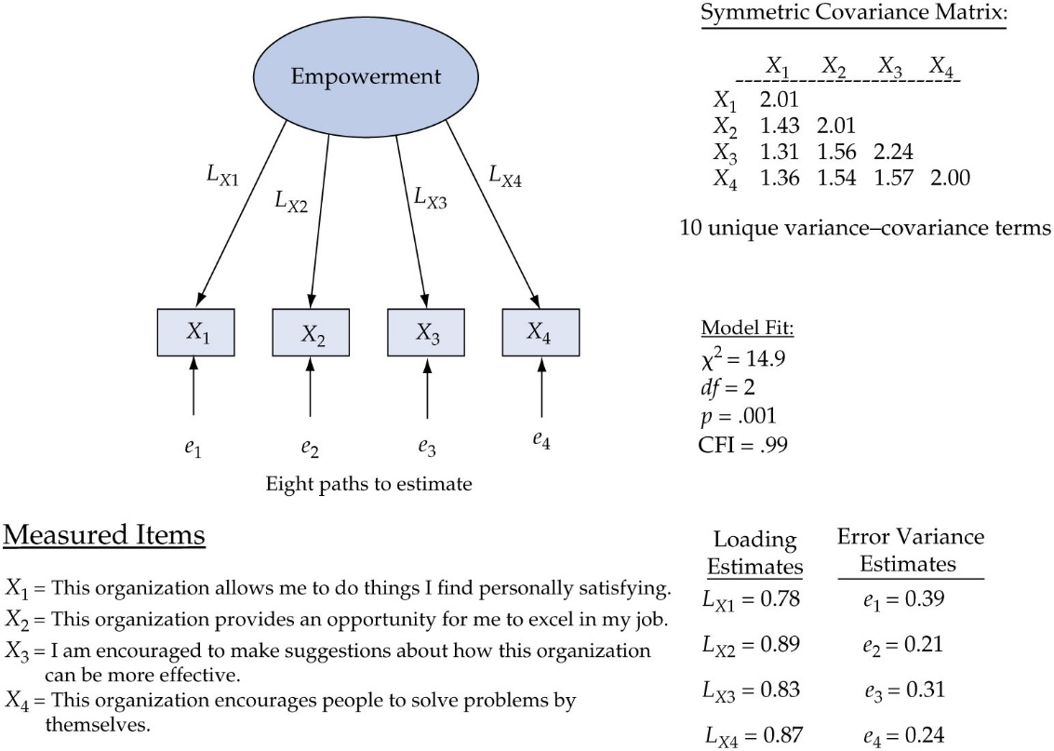
Identification
Over-identified Models are Desirable
Over-identified models estimate fewer parameters than number of unique elements in the covariance matrix
Net positive degrees of freedom result.
df = unique terms in covariance
matrix – # of parameters

Slide 26
Identification of a Construct -- 1, 2, 3 or 4 items
C₁
C₁
C₁
C₁
Parameters to be estimated:
Loading(s)
Error(s)
X₁
X₁
X₂
X₁
X₂
X₃
X₁
X₂
X₃
X₄
e
e
e
e
e
e
e
e
e
e
Number of unique var/covar | 1
Number of parameters | 2
Degrees of freedom | -1
identification | Under
Number of unique var/covar | 3
Number of parameters | 4
Degrees of freedom | -1
identification | Under
Number of unique var/covar | 6
Number of parameters | 6
Degrees of freedom | 0
identification | Just
Number of unique var/covar | 10
Number of parameters | 8
Degrees of freedom | 2
identification | Over

Slide 27
Identification With Multiple Constructs (2 items)
Are the individual constructs identified?
Is the model identified?
How is this possible?
Implications?
C₁
C₂
X₁
X₂
X₃
X₄
e
e
e
e
Number of unique var/covar | 10
Number of parameters | 9
Degrees of freedom | 1
identification | Over

Slide 28
Identification With Multiple Constructs (3 items)
C₁
C₂
Are the individual constructs identified?
Is the model identified?
How is this possible?
Implications?
X₁
X₂
X₃
X₄
X₅
X₆
e
e
e
e
e
e
Number of unique var/covar | 21
Number of parameters | 13
Degrees of freedom | 8
identification | Over

Slide 29
Some Conclusions – t rule
Single Construct Level
Constructs of 1 or 2 items -- require additional information/constraints to be identified
1 item – specify loading or error
2 items – specify equivalence of loadings or loading/error of one item
3 items -- Minimum number for Just Identification at construct level
4 or more items – Over identified at construct level
Model level (multiple constructs)
Constructs with at least two items – Over Identified

Slide 30
How many measured variables per latent construct?
In summary, when specifying the number of indicators per latent construct, the following is recommended:
Use at least four indicators whenever possible.
Having three indicators per construct is acceptable, particularly when other constructs have more than three.
Constructs with fewer than three indicators should be avoided or if used, constrained to identify.

Slide 31
Designing a Study to Produce Empirical Results
Scales with 3 or more reflective and reliable items seldom cause problems in estimation.
3 or more items avoids under-identification
Models can be identified but individual constructs with fewer than 3 items still are not identified in and of themselves, which can cause problems
Failure to converge
Illogical estimates
Heywood cases
Standardized facto loadings > 1
Negative variances

Slide 32
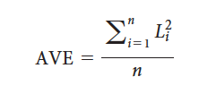
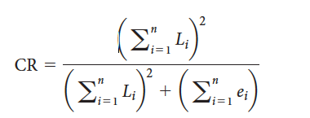
Assessing CFA Model Validity
Overall Construct Validity Requires
Good Model Fit (𝟀², df, CFI, RMSEA)
Convergent Validity
AVE – Average Variance Extracted
Average of the squared standardized factor
loadings
> .5 for all factors
CR – Composite/Construct Reliability
> .7 for all factors
Squared sum of the unstandardized factor loadings
divided by this number + the sum of the error variances
Discriminant Validity
AVE > r²
AVE for two latent factors should be more than the squared correlation between the two factors

Slide 33
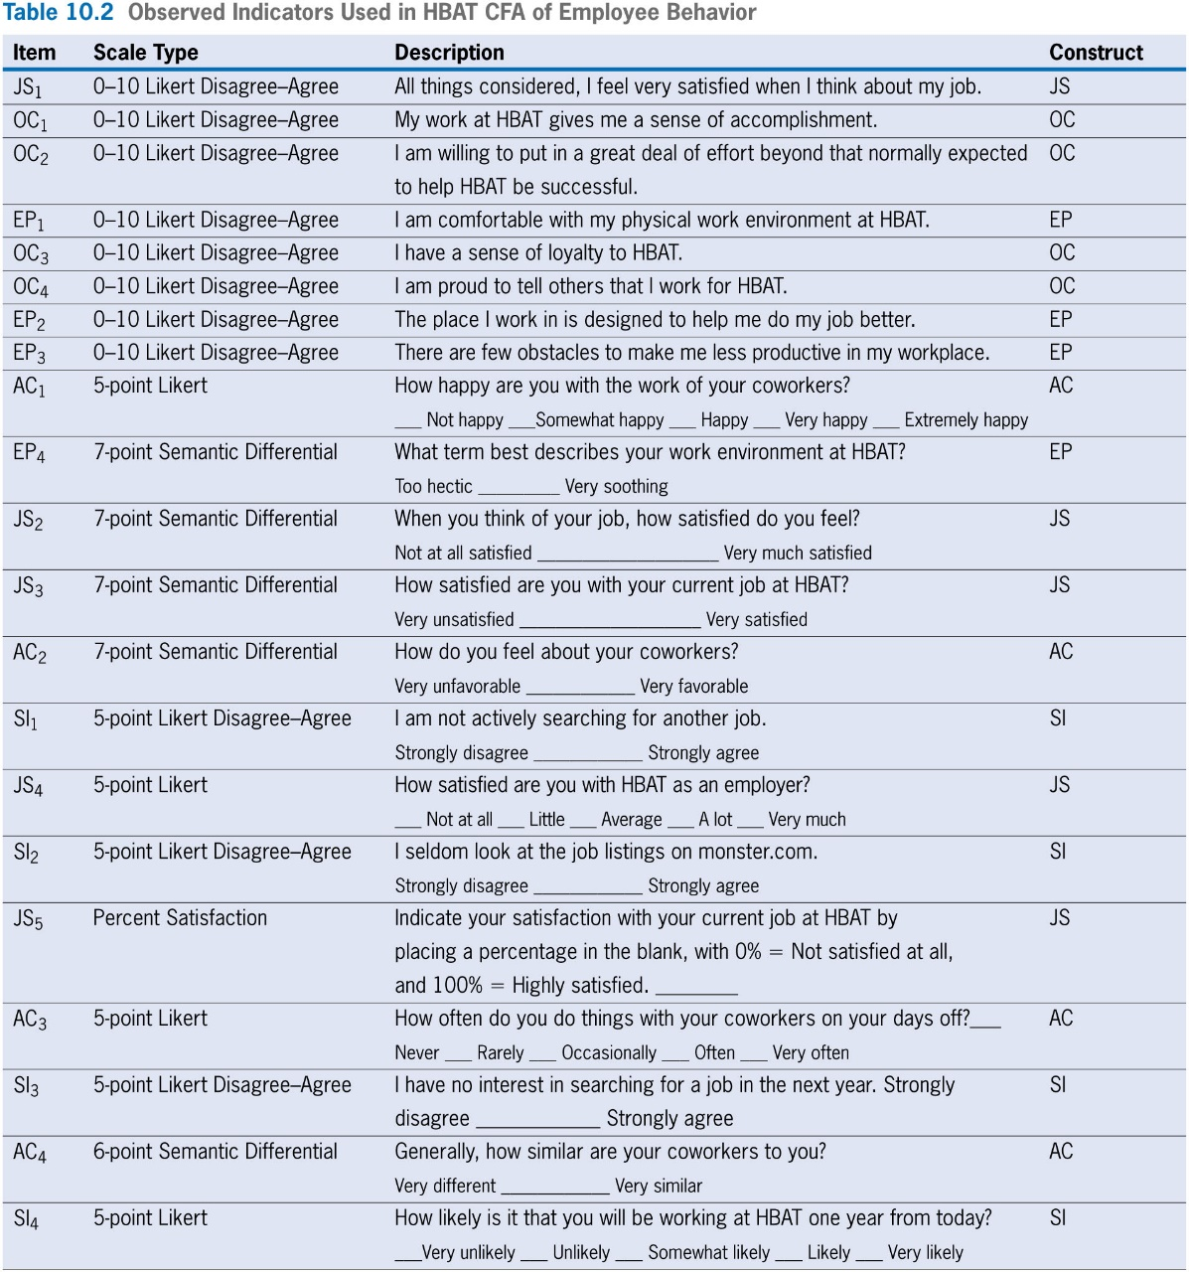
CFA Illustration
HBAT Theory of Employee Retention
5 Constructs
Staying Intention (SI)
Organizational Commitment (OC)
Job Satisfaction (JS)
Environmental Perception (EP)
Attitude toward Coworkers (AC)
Survey of Employees
400 HBAT Employees are Respondents
Survey Items Described in Table

Slide 34
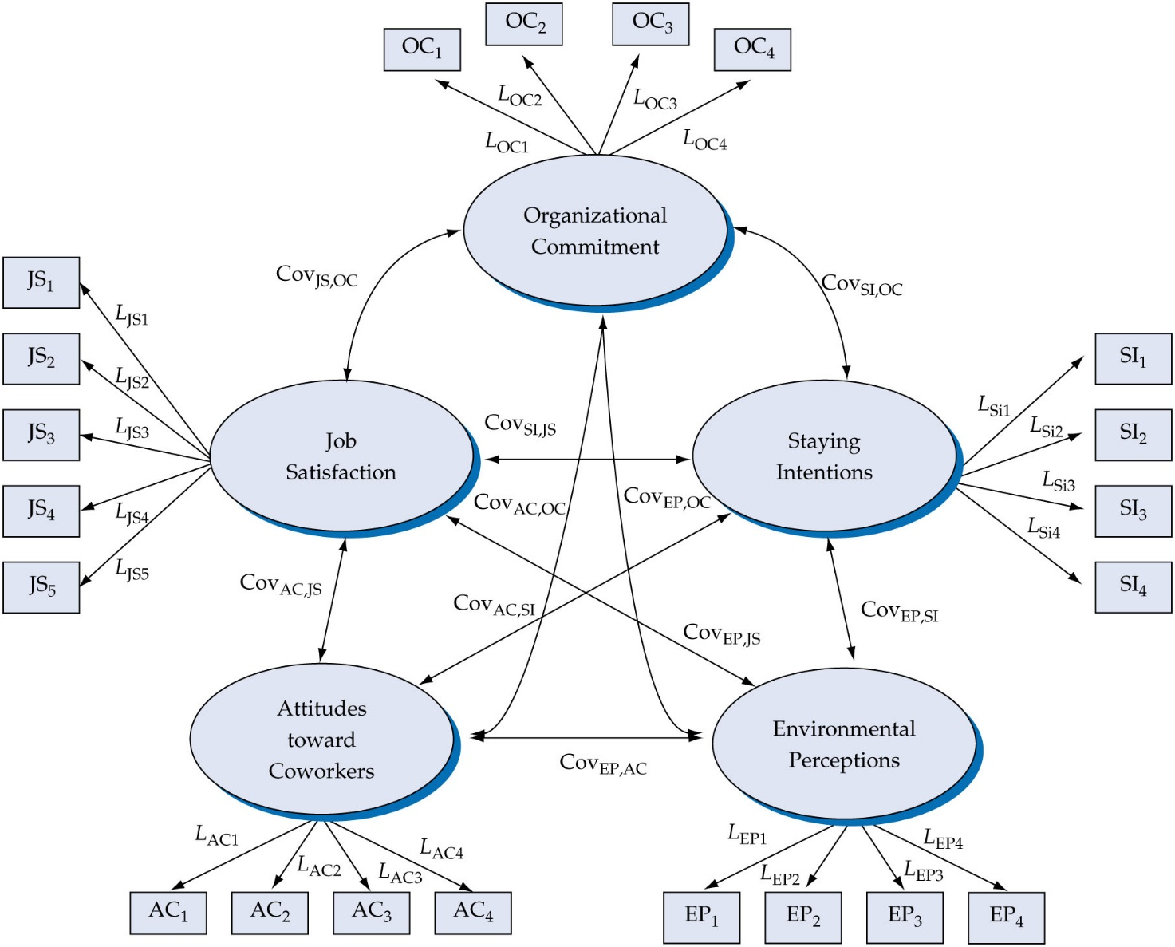
HBAT CFA
Specify Model as Shown Here
Error Variance Terms Not Shown
Each Error Variance Term is Presumed Independent
Identification
p(p+1)/2 = 21(21+1)/2=231 initial df
Estimate
16 Loadings (5 fixed to 1 to set scale for each construct)
21 Error Variances
10 Construct Covariances and 5 Construct Variances for a total of 15
Net df = 179
Model is over-identified

Slide 35
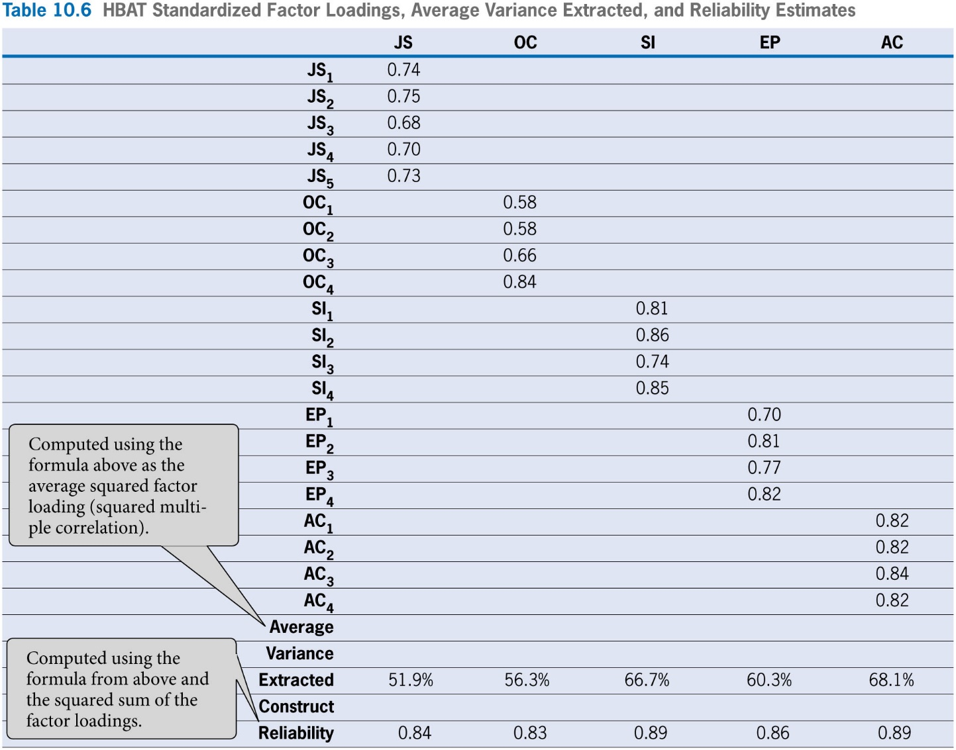
HBAT CFA Estimates
CFA Estimates Suggest:
Convergent Validity
Loadings high enough (lowest is 0.58)
AVEs all above 0.50.
Reliabilities all above .7
Discriminant Validity
AVEs > Squared Correlation Estimates (but not shown in the figure to the right)

Slide 36
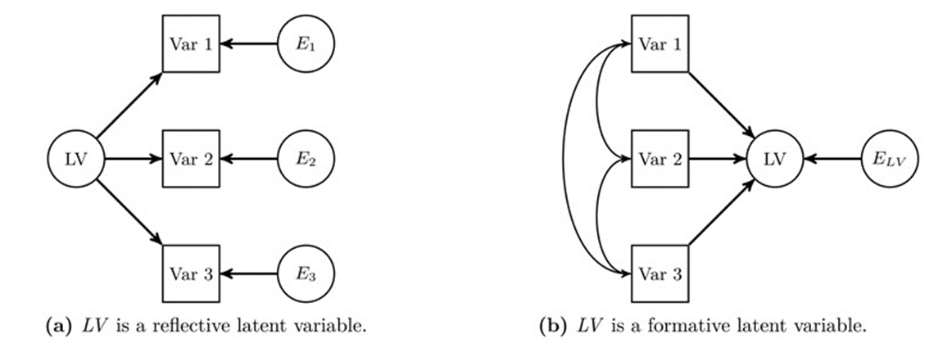
Reflective vs. Formative Models
Reflective measurement theories imply that latent factors cause the measured variables
Formative measurement scales imply that the measured variables cause the factors
Formatively modeled factors are under-identified without constraints

Slide 37
Next Class
Lecture Topics: CFA Extension – Measurement Invariance
CFA interpretation and issues
Multiple-samples analysis
Measurement invariance
Common method variance
R
Measurement invariance using lavaan
Readings that will be discussed
Textbook Chapter 16
Vandenberg & Lance (2000) [pages 4-11, 36-47, 55-58], Podsakoff (2003)

